Slide 1



RGUKT IIIT SRIKAKULAM
IMPULSE TO INSIGHT
Presented By TEAM QUAD | 19/06/2024

Slide 2
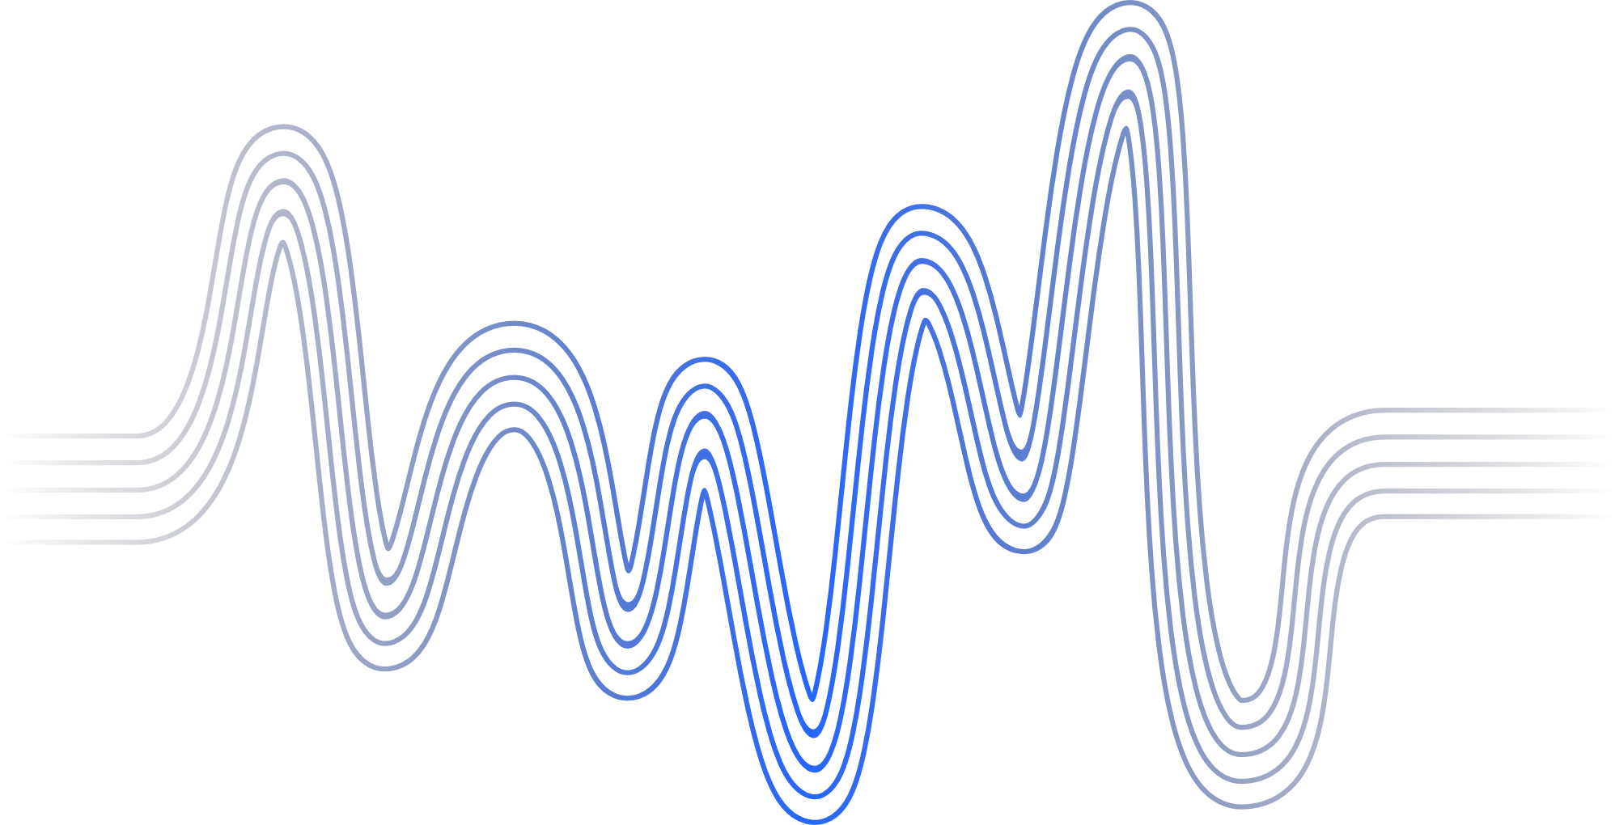
SYNOPSIS
ABSTRACT | 3
EXISTING SYSTEM AND ITS DISADVANTAGES | 4
PROPOSED SYSTEM AND ITS ADVANTAGES | 6
ALGORITHMS AND LIBRARIES USED | 7
FUTURE ENHANCEMENTS | 8
WORK FLOW | 9
CONCLUSION | 10

Slide 3
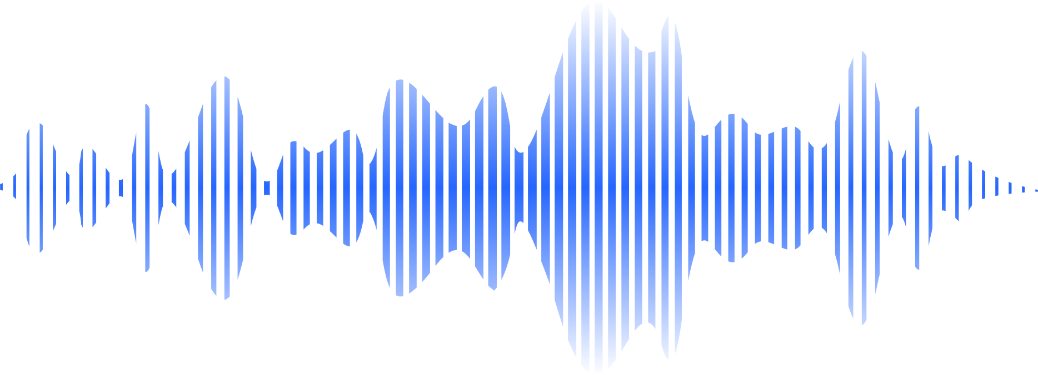
ABSTRACT:
In today's world of information overload, extracting key insights from spoken content is crucial. Our project introduces a state-of-the-art system that converts speech into text with good accuracy. By leveraging advanced technologies like Automatic Speech Recognition (ASR) and speaker diarization, it not only transcribes speech but also identifies different speakers.
Using Natural Language Processing (NLP), specifically tools like Transformers, the system then condenses this transcribed text into clear and concise summaries. This capability saves time and enhances productivity, making it easier to manage large volumes of audio information in fields such as business, education, and media. Our system represents a significant advancement in speech processing technology, designed to streamline information processing and improve accessibility.

Slide 4
EXISTING
SYSTEMS:
1.GOOGLE SPEECH-TO-TEXT (FORMERLY GOOGLE CLOUD SPEECH API)
2.MICROSOFT AZURE SPEECH SERVICES
3.IBM WATSON SPEECH TO TEXT
4.DRAGON NATURALLYSPEAKING (NUANCE)

Slide 5
EXISTING SYSTEM DISADVANTAGES:
Privacy and Data Security: Users may have concerns about their audio data being stored on third-party servers and potential risks of data breaches.
Cost: Some services can be costly, particularly for high volumes of usage or additional features beyond basic transcription.
User Interface and Accessibility: The usability of these systems can vary, affecting user experience and adoption rates.

Slide 6
PROPOSED SYSTEM ADVANTAGES:
Integrated Functionality: Combines transcription and summarization in one platform for streamlined workflow.
Cost-effectiveness: Offers a cost-effective solution with potential savings on operational expenses.
User-friendly Interface: Features an intuitive interface for easy navigation and accessibility.
User-friendly Output: Users can easily copy the produced transcriptions and summaries from the system's interface.

Slide 7
ALGORITHMS
LIBRARIES
1.SPEECH_RECOGNITION
SPEAKER DIARIZATION
2.PYAUDIOANALYSIS
AUDIO SEGMENTATION
3.PYDUB
SPEECH RECOGNITION
4.WAVE
BART (BIDIRECTIONAL AND AUTO-REGRESSIVE TRANSFORMERS)
5.TRANSFORMERS

Slide 8
FUTURE ENHANCEMENTS:
Multi-language Support: Extend support beyond English to include other languages commonly spoken globally, enhancing the system's versatility and appeal to a broader user base.
Customizable Summarization Length: Allow users to specify the desired length or level of detail for summaries, catering to different needs such as detailed analysis or concise overviews.
Enhanced Audio Processing: Improve audio preprocessing techniques to handle various audio qualities and environmental noise, ensuring robust performance and accuracy in transcription.
Automatic Topic Identification: Implement algorithms to automatically identify and categorize topics discussed in the audio, enabling structured organization and retrieval of information.

Slide 9
WORKING
PERFORM SPEAKER DIARIZATION
PERFORM SPEAKER DIARIZATION
INPUT AUDIO FILE
COMPILE TRANSCRIPT
TRANSCRIBE CONVERSATION
SPLIT AUDIO BY SPEAKER
PIPELINE CREATION
SUMMARIZATION
OUTPUT

Slide 10
CONCLUSION:
Our project introduces a system for transforming English audio into accurate transcriptions and concise summaries. By combining advanced Automatic Speech Recognition (ASR) and Natural Language Processing (NLP), we offer a streamlined solution that enhances productivity and accessibility across diverse fields. With user-friendly features and potential for future enhancements, our system aims to revolutionize how organizations manage and extract insights from spoken content.

Slide 11
THANK YOU
PREASENTED BY:
TEAM NUMBER: 25
PATNANA GAYATHRI
LEBAKA PAVAN NAGA SAI
THONTLA KASI REDDY
VADLAMURI MANI SANDEEP

